Slide 1
Chapter 3 Communication Networks
Dr.Mohammed Abdalla Youssif
1

Slide 2
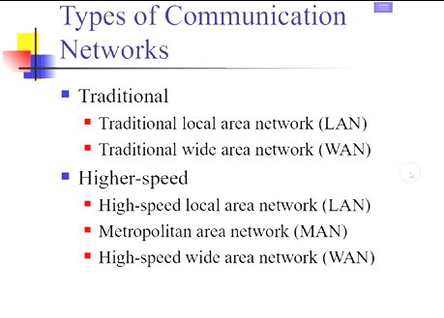
2
Notes:
Wireless Communications and networks – William Stallings
2

Slide 3
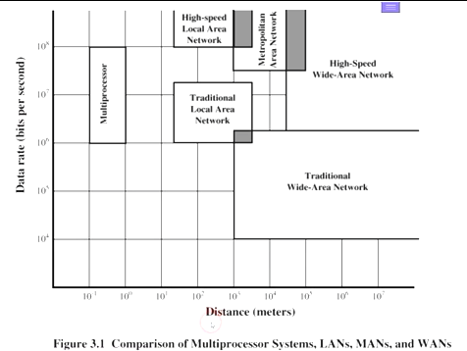
3
Notes:
Wireless Communications and networks – William Stallings
3

Slide 4
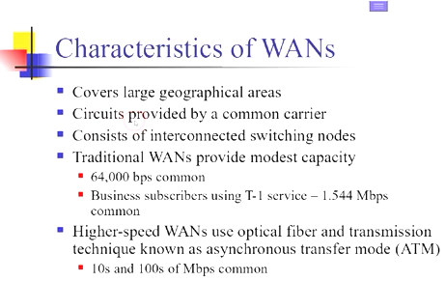
4
Notes:
Wireless Communications and networks – William Stallings
4

Slide 5
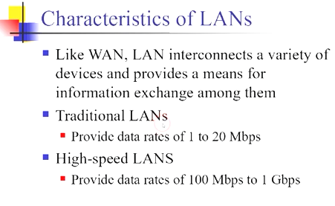
5
Notes:
Wireless Communications and networks – William Stallings
5

Slide 6
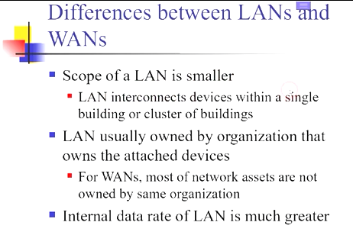
6
Notes:
Wireless Communications and networks – William Stallings
6

Slide 7
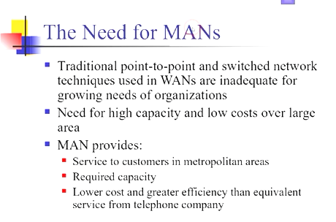
7
Notes:
Wireless Communications and networks – William Stallings
7

Slide 8
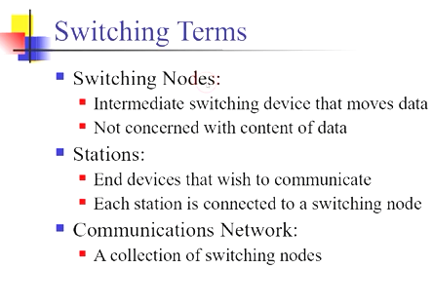
8
Notes:
Wireless Communications and networks – William Stallings
8

Slide 9
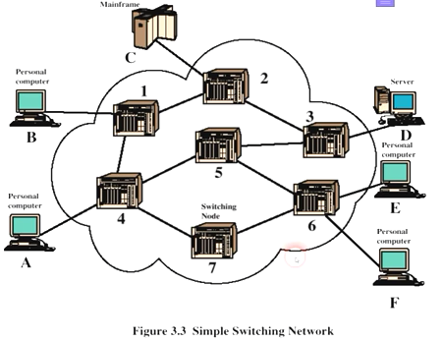
9
Notes:
Wireless Communications and networks – William Stallings
9

Slide 10
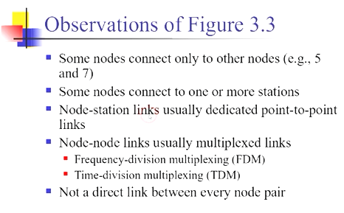
10
Notes:
Wireless Communications and networks – William Stallings
10

Slide 11
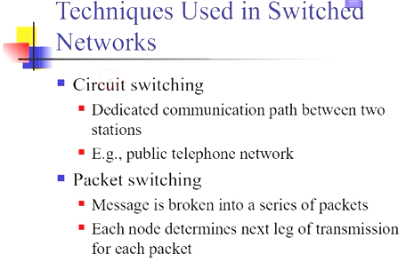
11
Notes:
Wireless Communications and networks – William Stallings
11

Slide 12
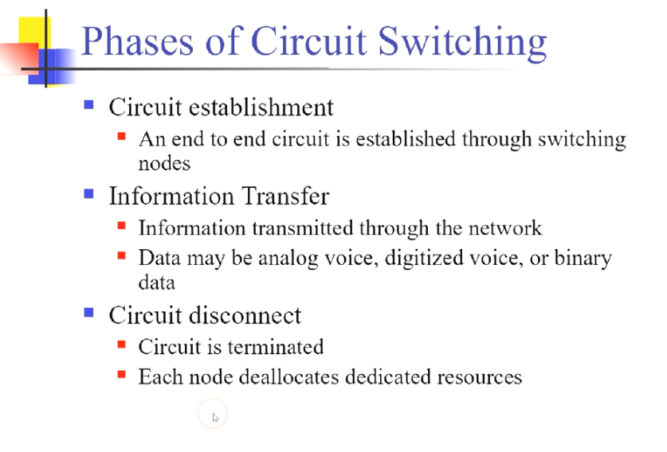
12
Notes:
Wireless Communications and networks – William Stallings
12

Slide 13
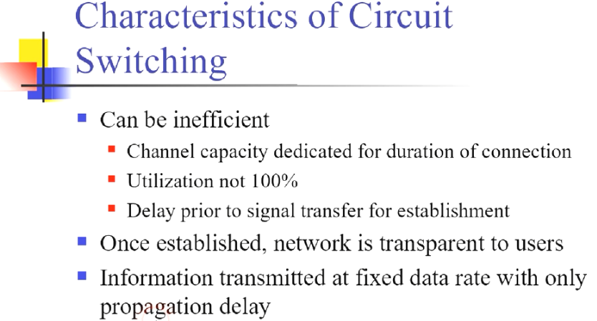
13
Notes:
Wireless Communications and networks – William Stallings
13

Slide 14
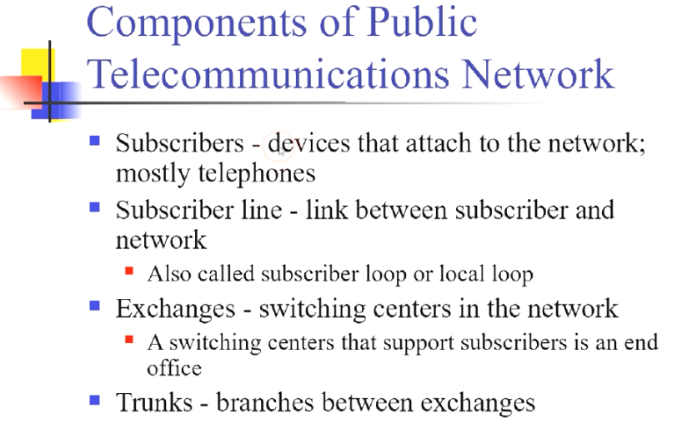
14
Notes:
Wireless Communications and networks – William Stallings
14

Slide 15
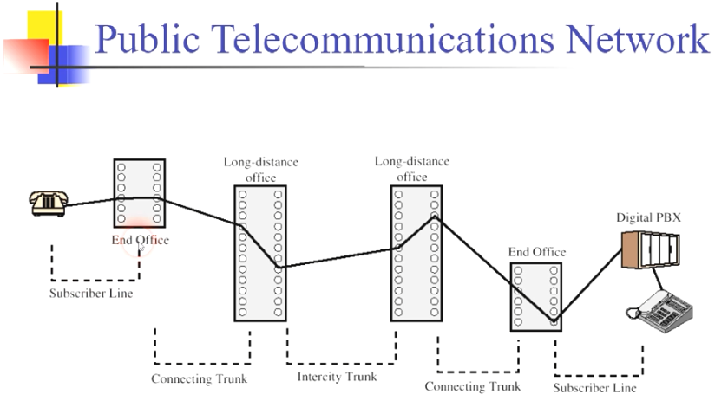
15
Notes:
Wireless Communications and networks – William Stallings
15

Slide 16
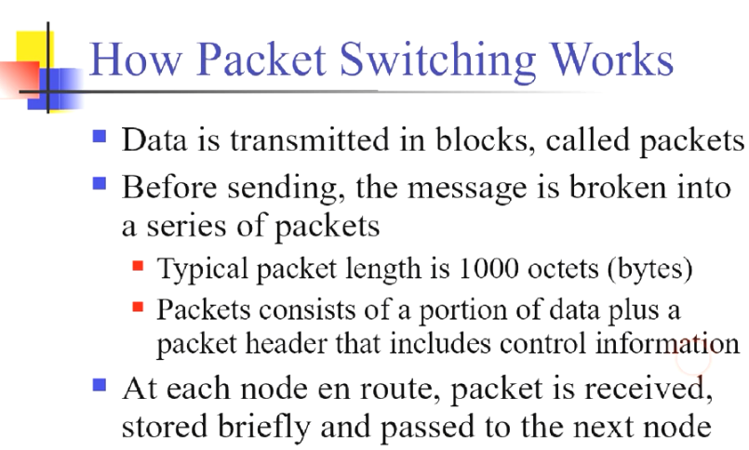
16
Notes:
Wireless Communications and networks – William Stallings
16

Slide 17
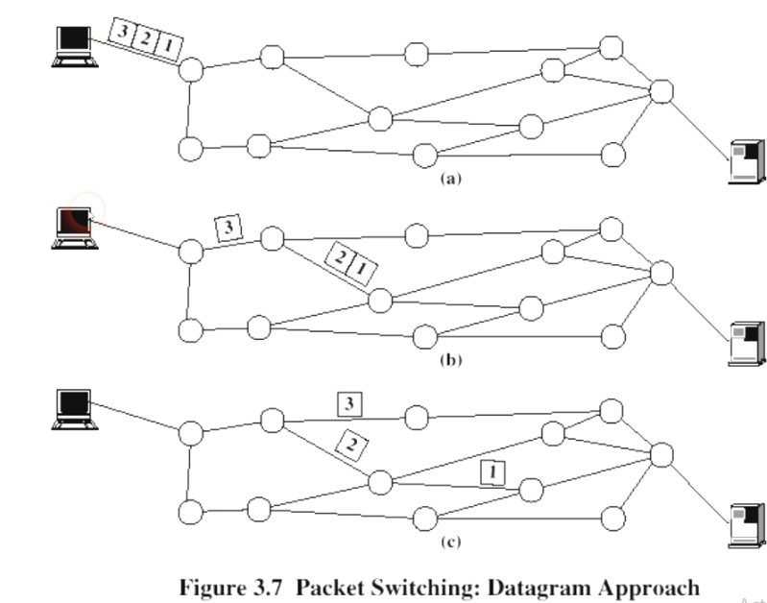
17
Notes:
Wireless Communications and networks – William Stallings
17

Slide 18
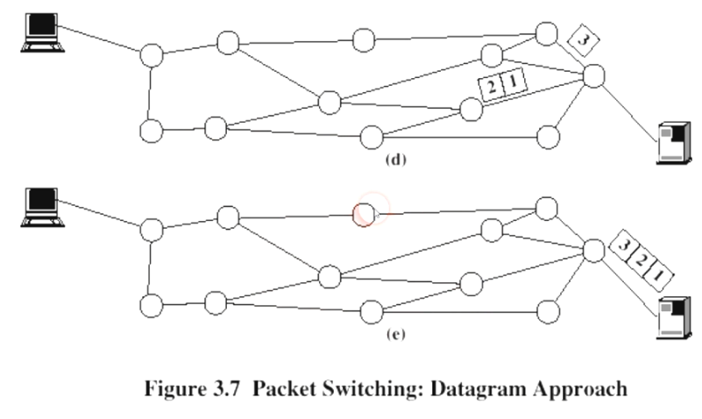
18
Notes:
Wireless Communications and networks – William Stallings
18

Slide 19
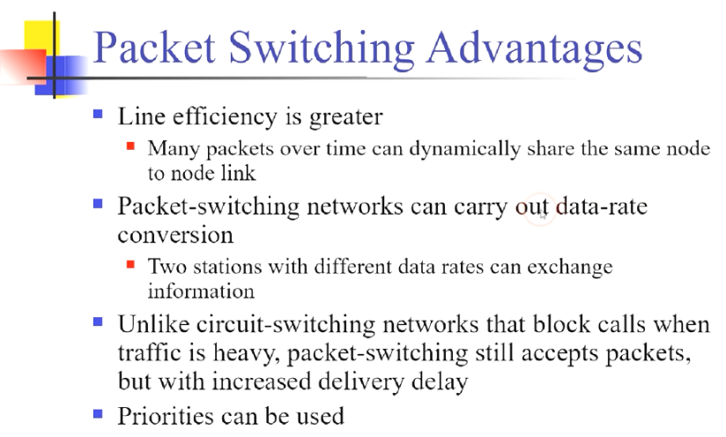
19
Notes:
Wireless Communications and networks – William Stallings
19

Slide 20
20
Notes:
Wireless Communications and networks – William Stallings
20

Slide 21
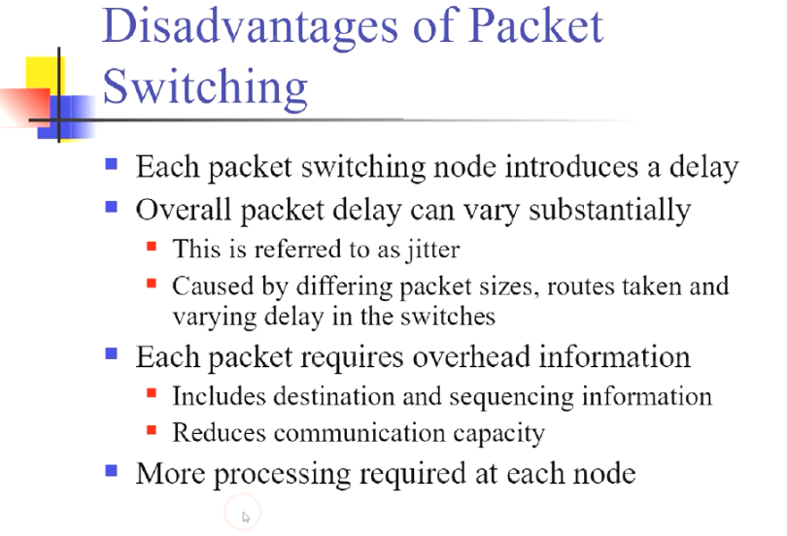
21
Notes:
Wireless Communications and networks – William Stallings
21

Slide 22
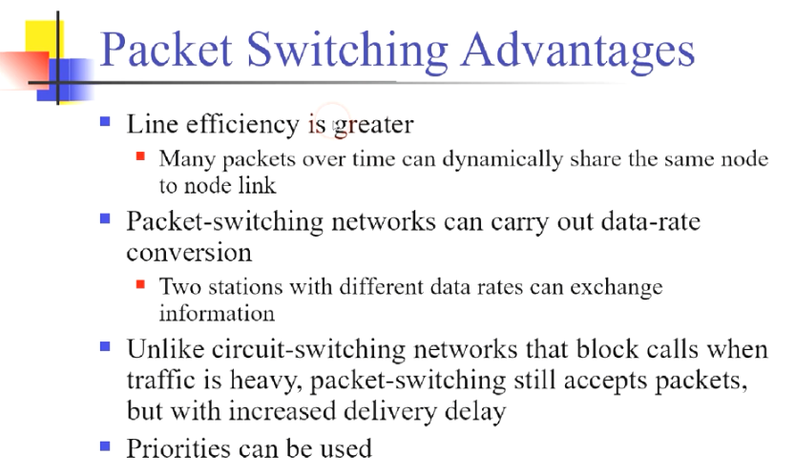
22
Notes:
Wireless Communications and networks – William Stallings
22

Slide 23
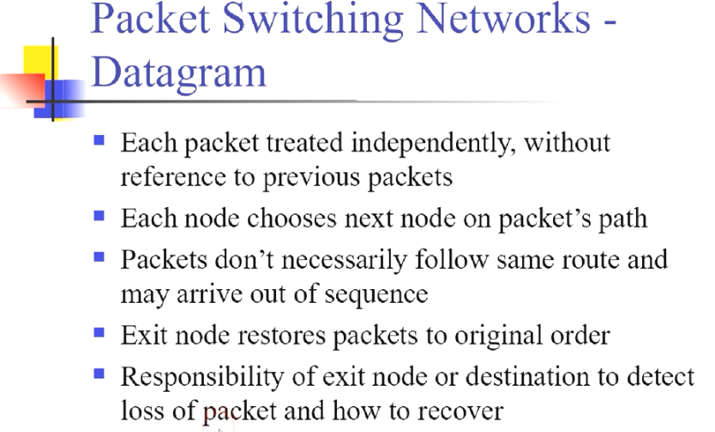
23
Notes:
Wireless Communications and networks – William Stallings
23

Slide 24
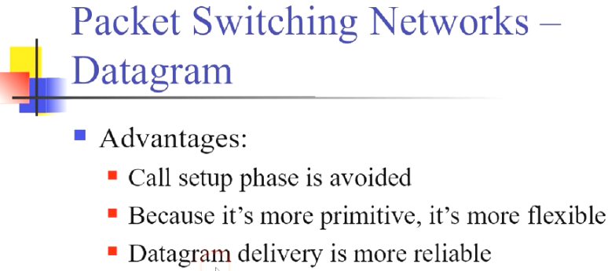
24
Notes:
Wireless Communications and networks – William Stallings
24

Slide 25
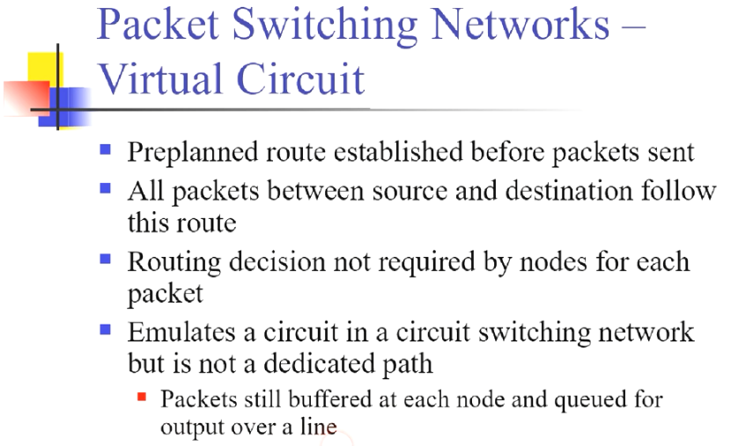
25
Notes:
Wireless Communications and networks – William Stallings
25

Slide 26
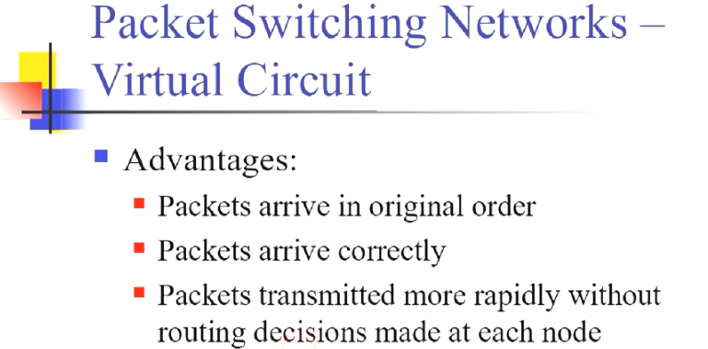
26
Notes:
Wireless Communications and networks – William Stallings
26

Slide 27
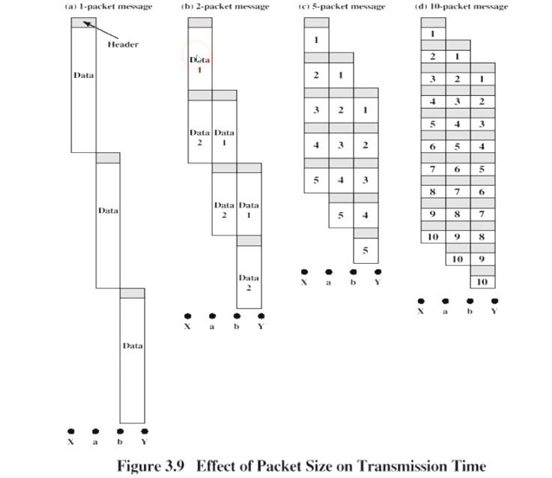
27
Notes:
Wireless Communications and networks – William Stallings
27

Slide 28
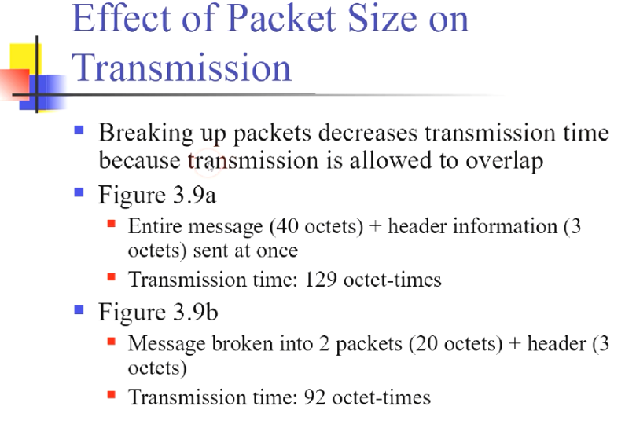
28
Notes:
Wireless Communications and networks – William Stallings
28

Slide 29
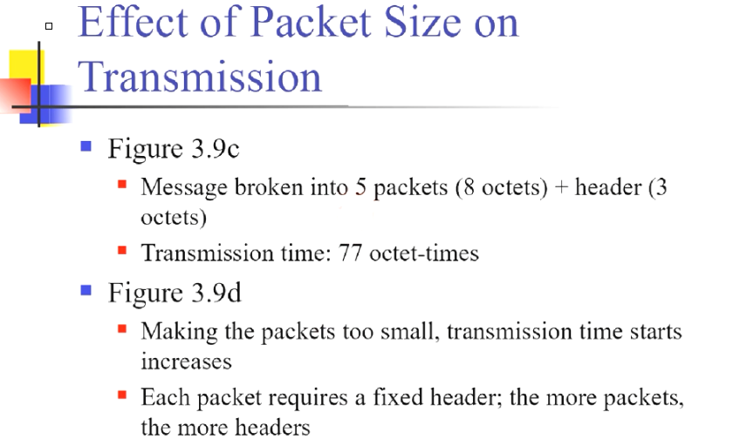
29
Notes:
Wireless Communications and networks – William Stallings
29

Slide 30
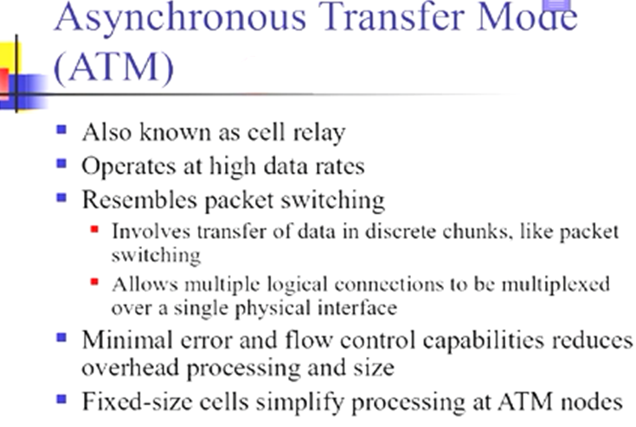
30
Notes:
Wireless Communications and networks – William Stallings
30

Slide 31
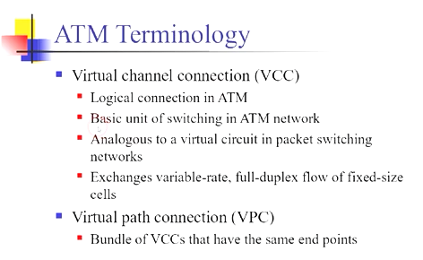
31
Notes:
Wireless Communications and networks – William Stallings
31

Slide 32
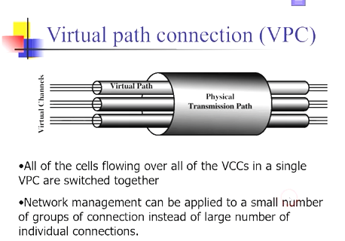
32
Notes:
Wireless Communications and networks – William Stallings
32

Slide 33
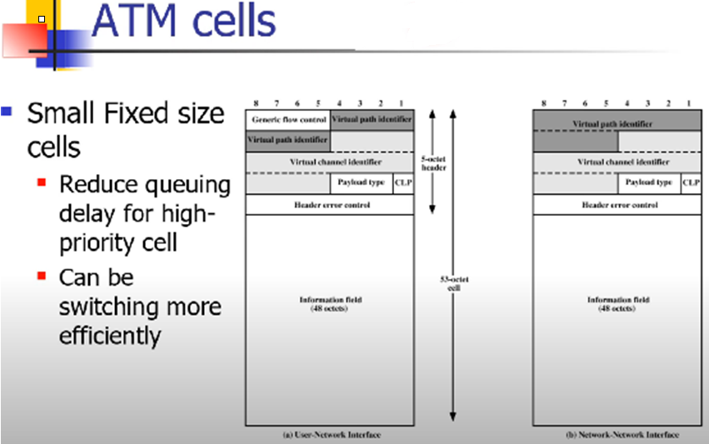
33
Notes:
Wireless Communications and networks – William Stallings
33

Slide 34
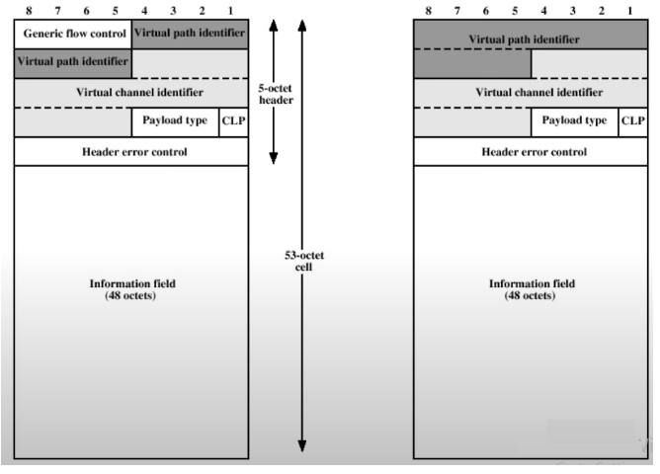
34
Notes:
Wireless Communications and networks – William Stallings
34

Slide 35
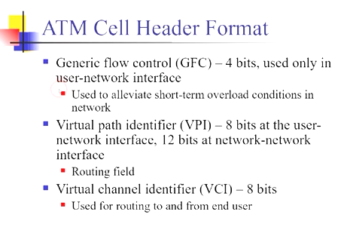
35
Notes:
Wireless Communications and networks – William Stallings
35

Slide 36
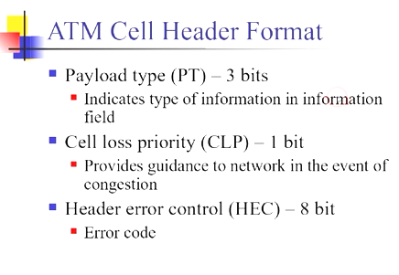
36
Notes:
Wireless Communications and networks – William Stallings
36

Slide 37
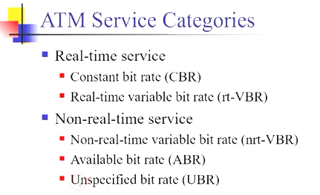
37
Notes:
Wireless Communications and networks – William Stallings
37

Slide 38
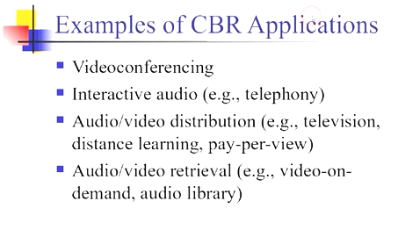
38
Notes:
Wireless Communications and networks – William Stallings
38

Slide 39
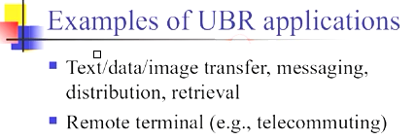
39
Notes:
Wireless Communications and networks – William Stallings
39

Slide 40
Questions ?
40
Notes:
40

